Slide 1

Coffee Sales Interactive Dashboard

Slide 2
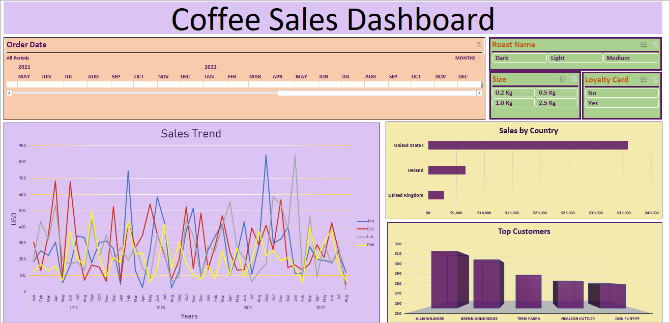

Slide 3
Data Source
https://www.youtube.com/watch?v=m13o5aqeCbM

Slide 4
Instructions For Project Review
Use Ctrl+pg up or pg dn to navigate through the pages as I have removed sheet tabs to format the Dashboard.
Select timeline for specific time period review and select the specific slicer for the filtration purpose.
XLOOKUP has been used in worksheet to retrieve data from other sheets. The XLOOKUP function is only available in Excel for Microsoft 365, Excel 2021, and Excel for the web.
Can also use Add-ins for Excel32bit or Excel64bit to use XLOOKUP for any other version.
Go to https://github.com/Excel-DNA/XFunctions/releases/tag/v0.2-alpha for downloading the add-in for XLOOKUP.

Slide 5
Excel Functions & Tools
XLOOKUP (To look up values from different sheet)
INDEX & MATCH (To look up values for different columns at once from different sheet)
IF function ( To set conditional replacements)
PIVOT TABLE (To Summarize the data)
CHARTS (For Dashboard)

Slide 6
Project Insights
Over all United States tops the charts of the sales which implies that customers from United States as a whole is the top buyer of coffee for a period of four years. Ireland stands on 2nd place and United Kingdom at 3rd. It implies that United States is the biggest market for coffee.
“Arabica” and “Liberica” were the top selling coffee till date. The sales for these two were highest in 2021 for about more than $ 800.
United States remains the top buyer consistently throughout four years.
Robusta remains the lowest selling coffee over the period of four years.
Top four customers are from United States and fifth is from United Kingdom.

Slide 7
Thank You

